Slide 1
CHAPTER 01
COMPLEXITY
A very old, highly intuitive, and still common argument for the existence of god is the Argument from Design.
The trust of the argument is that the ordered complexity exhibited by the universe as a whole, and in particular by living things, is evidence that there must be an intelligent designer, since the existence of such complexity cannot be otherwise explained.
So, the word “design” as used in this argument refers to the order and incredible complexity not just in biological systems. But
also in the very intricate (complicated or difficulty) law of nature that operate through the universe. So, design and complexity is not same.
So. It means every things are complex, but it is designed.

Slide 2
Refers to the emergence of collection properties in systems with a large number parts in interaction among them.
The study of complex systems is about understanding indirect effects. Problems that are difficult to solve are often hard to understand because the causes and effects are not obviously related.
About Software Complexity
To produce reliable software, its complexity must be controlled by suitably decomposing the software systems into smaller subsystems.
Both internal and external complexity of a module.

Slide 3
1. Complexity
A Physician, a Civil engineers and a Computer Scientist where arguing about what was the oldest profession in the world.
  Physician remarked – “Well in the bible, it says that god created eve from a rib taken out of Adam”.
  This is clearly required surgery.
  So every physician can rightly claim that mine is the oldest profession in the world.
  The Civil Engineer interrupted and said” God created the order of the heavens & the earth from out of the Chaos”. (brings in organized form)
  Doctor said “Mine is the oldest profession in the world”.
  So, Computer Scientist leaned back in her chair, and smiled, and then said, ”Ah, but who do you think created the chaos”.

Slide 4
So, everybody can say complexity is an essential property of all software system for better understand and better management.
That property of a language expression which makes it difficult to formulate its overall behavior even when given almost complete information about its atomic components and their inter-relations.

Slide 5
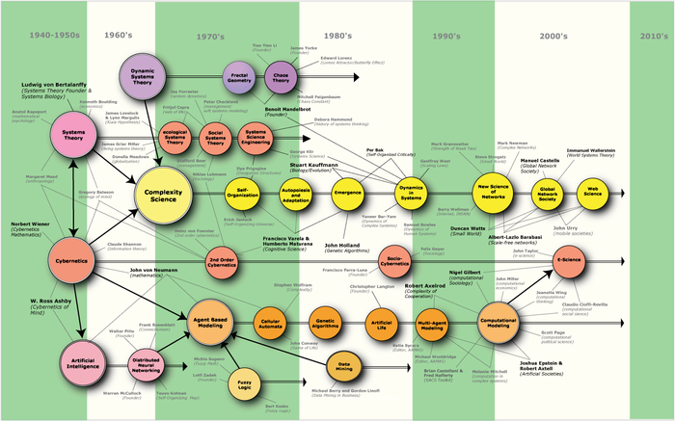
The Historical Complex Map to Read

Slide 6


Image for Complexity

Slide 7

Complex Systems
For our purpose complex systems (Booch):
  have many states, i.e. large "phase space",
  are hard to comprehend in total
  hard to predict
Examples:
  ant colony, an ant
  computer
  weather
  a car

Slide 8
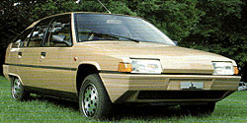
Complex Systems
Attributes of complex systems
  hierarchical
  components
  primitive components
  few kinds of subsystems in many different combinations
  evolved from a simpler system

Slide 9
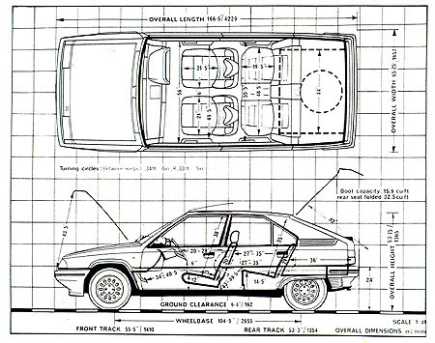
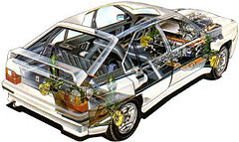
Complex Systems: Hierarchical
Composed of interrelated subsystems
  subsystems consist of subsystems too
  until elementary component

Slide 10
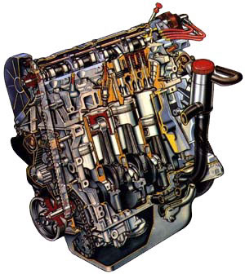
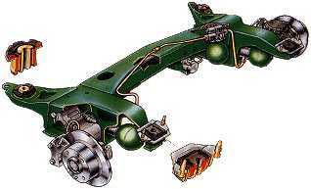
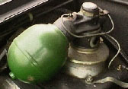
Complex Systems: Components
Links (dependencies) within a component are stronger than between components
  inner workings of components separated from interaction between components
  service/repair/replace components

Slide 11
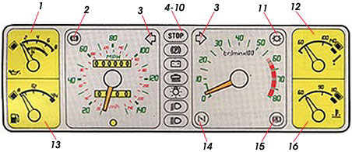
Complex Systems: Primitive Components
There are primitive components
  but defintion of primitive may vary
  Nuts, bolts, individual parts?
  replaceable components?
Instrument panel
or srews, bulbs and parts?

Slide 12



Complex Systems: Few kinds of subsystems in many combinations
There are common patterns
  Nuts, bolts, screws interchangeable
  cables, bulbs, plugs
  toothweels, belts, chains
  hoses, clamps

Slide 13
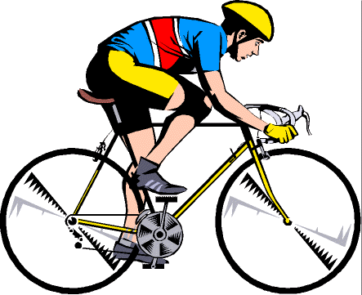
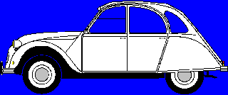
Complex Systems: Evolved from a simpler system
Complex system designed from scratch rarely works
Add new funtionality/improvements in small steps

Slide 14
Complex Systems: Two orthogonal views
The Object Structure
  "part of" hierarchy, functions
  concentrate on actual components
  concrete
The Class Structure
  "is a" hierarchy
  concentrate on kinds of components
  abstract

Slide 15
Complexity Crisis
What’s the most important problem in Computer Science?
Languages, tools, programming?
Well, according to growing number of researchers and computer users, it’s software complexity.
According to Vice-President of IBM Research Alfred Spector says about this problem for 40 years.
“This is probably the number one problem ……

Slide 16
People don’t understand very well but developers are essentially working in the same ways, with the same tools to create the applications that must be vastly more powerful.
There are some possible correlation between complexity measure:
    Execution -> usefulness
    Program Quality -> debugging, Correctness, Reliability etc.
    Mental effort to understand functionality -> Reuse, Maintenance, and Flexibility.

Slide 17
Goal and Complexity:
SIMPLE BRICKS USED TO BUILD WALL
COMPLEX BRICKS USED TO PREDICT WHERE IT WILL BRAKE
BRICKS ARE NITHER SIMPLE NOR COMPLEX
SO COMPLEXITY DEPENDS ON THE GOAL

Slide 18
General Idea of How to Deal with Complexity
Divide Abstraction
  Concept
  Thought
  Idea
  construct
  Generalization
  fact

Slide 19
Inherent Complexity of S/W:
Why Software is Inherently (inbuilt) Complex?
To better understand, complexity is an essential property of all S/W system. Why?
According to Brooks Suggestion” The complexity of S/W is an essential property, not an accidental one”.

Slide 20
So, we observe that this inherent complexity derives from four elements:
1. The complexity of the problem domain(area/field)
2. The difficulty of managing the development process.
3. The flexibility possible through software
4. The problems of characterizing the behavior of discrete (separate) system.

Slide 21
The Complexity of the Problem Domain:
The problem we try to solve in software frequently or repeatedly involve elements that are very complex exists between the users of a system & its developers
So, users generally find it very hard to give precise expression to their needs in a form that developers can understand.
A large S/W system is a capital investment, we can not afford to scrap an existing system every time its requirements change.

Slide 22
A further complication is that the requirements of a software system often change during its development, largely because the very existence of a software development project alters the rules of the problem.

Slide 23
2. The Difficulty of Managing the Development Process:
The fundamental task of the software development team is to engineer the illusion of simplicity – to shield users from this vast and often arbitrary external complexity.
Certainly, size is no great virtue in a software system.
We strive to write less code by inventing clever and powerful mechanisms that give us this illusion of simplicity.
If we decompose our S/W implementation in meaningful ways, we stop end up with hundreds and sometimes thousands of separate models.

Slide 24
The amount of work demands that we use a team of developers, and ideally we use as small a team as possible.
More developers means more complex communication and hence more difficult coordination, particularly if the team is geographically disperse, as is often the case in very large project.
With a team of developers, the key management challenge is always to maintain a unity and integrity of design.

Slide 25
3. The Flexibility Possible Through Software Systems:
A home building company generally does not operate its own tree farm from which to harvest trees for lumbers;
It is highly unusual for a constructions firm to build an on-site steel mill to forge custom girders for a new building.
Same as in the software industry such practice is common. Because S/W offers the ultimate flexibility, so it is possible for a developer to express almost any kind of abstractions.

Slide 26
4. The Problems of Characterizing the Behavior of Discrete Systems:
If we toss a ball into the air, we can reliably predict its path because we know that under normal conditions, certain laws of physics apply.
Software simulation of this ball’s motion, exactly that kind of behavior can easily occur.
Within a large application: may be 1000 of variables, current values, current address and calling stack of each process within the constitute the present state of the application.
Because we execute our S/W on digital computers, we have a system with discrete states.
Execute the motion of the tossed ball which are continuous functions.

Slide 27
The Structure of Complex System:
Examples of Complex Systems
  The Structure of a Personal Computer
  The Structure of Plants and Animals
  The Structure of Matter
  The Structure of Social Institutions
The Structure of a Personal Computer:
A personal computer is a device of moderate complexity.
Most of them are composed of the same major elements:
    a central processing unit. a monitor, a keyboard, and some sort of secondary storage device, usually either a floppy disk or a hard disk drive.

Slide 28
    We may take any one of these parts and further decompose it.
    For examples: a CPU typically encompasses primary memory, an arithmetic/logic unit, and a bus to which peripherals devices are attached.
    Each of these parts may in turn be further decomposed: an ALU may be divide into registers and random control logic, which themselves are constructed from even more primitive elements, such as NAND gates, inverters, and so on.
    Here we can see the hierarchic nature of a complex system.

Slide 29
The Structure of Plants and Animals:
In botany, scientists seek to understand the similarities and differences among plants through a study of their morphology, that is, their form and structure.
So, plants are complex multi-cellular organisms, and from the cooperative activity of various plant organ systems arise such complex behaviors as photosynthesis and transpiration.
So, Plants consists of three major structures (roots, steams, and leaves), and each of these has its own structures.
For examples: roots -> branch roots, root hairs, root apex, & root cap.

Slide 30
So, all parts at the same level of abstraction interact in well-defined ways.
For example, at the highest level of abstraction, roots are responsible for absorbing water and minerals from the soil.
So, roots interact with stems, which transport these raw materials up to the levels.
The leaves in turn use the water and minerals provided by the steam to produce food through the photosynthesis.
So, there are always clear boundaries for functionality of plants. There are clear interaction between all parts simultaneously.
A number of mechanisms above the cellular level are also shared by plant & animal life.

Slide 31
The Structure of Social Institutions:
As a final example of complex systems, we turn to the structure of social institutions.
Means, group of people join together to accomplish tasks that cannot be done by individuals.
The relationship among the various parts of a large organization are just like those found among the components of a computer, or a plant, or even a galaxy.
Specifically, the degree of interaction among employees within an individual office is greater than the employees of different offices.

Slide 32
The Five Attributes of a Complex System:
According to Simon and Ando, there are five attributes common to all complex systems.
Frequently, complexity takes the form of hierarchy, whereby a complex system is composed of interrelated subsystems that have in turn their own subsystem, and so on, until some lowest level of elementary components is reached.
The choice of what components in a system are primitive is relatively arbitrary and is largely up to the discretion of the observer of the system.

Slide 33
3. Intra-component linkages are generally stronger than inter-component linkages. This fact has the effect of separating the high frequency dynamics of the components – involving the internal structure of the components – from the low-frequency dynamics – involving interaction among components.
Hierarchic systems are usually composed of only a few different kinds of subsystems in various combinations and arrangements.
A complex system that works is invariably found to have simple system that worked ….. A complex system designed from scratch never works and cannot be patched up to make it work. You have to start over, beginning with a working simple system.

Slide 34
Bringing Order to Chaos:
The Role of Decomposition:
According to Dijkstra “The technique of mastering complexity has been known since ancient times: divide and rule.
When designing a complex software system, it is essential to decompose it into smaller and smaller parts, each of which we may then refine independently.
For the decomposition of complex software system, we should follow the following decompositions:
Algorithmic Decomposition: Most of us have been formally trained in the system of top-down structured design, and so we approach decomposition as a simple matter of algorithmic decomposition, wherein each module in the system denotes a major step in some overall process.

Slide 35
Algorithmic Decomposition
Update file
Get master area
Get formatted update
Put new master area
Get OK master
Expand
This is an example of algorithmic decomposition which shows one of the product of structured design
It shows the relationships among various functional elements of the solution.
This particular structure chart illustrates part of the design of a program that updates the content of a master file.

Slide 36
2. Object-Oriented Decomposition:
  We suggest that there is an ultirnate decomposition possible for the same problem.
Get formatted update
Master File
File of Updates
Update
Get Put Create
Match
Update to Card
Get Reformat
Master Record
Check Sum
Is Valid Add
This figure display decomposed the system according to the key abstractions in the problem domain.
Here decomposing the problem into steps such as Get formatted, update and Add check sum, we have identified objects such as Master File and Check Sum.

Slide 37
Here by the decomposition, we view the world as a set of autonomous agents that collaborate to perform some higher level behavior.
It is an operation associated with the object File of Updates. By the calling this operation creates another object Update to Card.

Slide 38
On Designing Complex Systems:
Engineering as a Science and an Art:
The conception of a design for a new structure can involve as much a leap of the imagination and as much a synthesis (mixture) of experience and knowledge as any artist is required to bring to his canvas or paper.
But the role of the engineer as artist is particularly challenging when the task is to design an entirely new system.
This is the most common circumstance in software engineering.
Especially in the case of reactive systems and systems for command and control, we are frequently asked to write software for an entirely unique set of requirements.

Slide 39
The Meaning of Design:
In every engineering discipline, design include or cover the disciplined approach which we use to invent a solution for some problem, thus providing a path from requirements to implementation.
In the context of software engineering, Mostow suggests that the purpose of design is to construct a system that:
  “Satisfies a given functional specification
  Conforms to limitations of the target medium.
  Meets implicit or explicit requirements on performance and resource usage.
  Satisfies implicit or explicit design criteria on the form of artifact.
  Satisfies restrictions on the design process itself, such as its length or cost, or the tools available for doing the design.

Slide 40
The Elements of Software Design Method:
The software engineering community has evolved dozens of different design methods, which we can loosely classify into three categories.
Despite their differences, all of these methods have element in common.
Specifically, each method includes the following:
  Notation: The language for expressing each model.
  Process: The activities leading to the orderly construction of the system’s models.
  Tools: model building which enforce rules about the models themselves; the errors and inconsistencies can be exposed.

Slide 41
The Models of Object-Oriented Development:
“Is there a best design method? There is no absolute answer to this question.
There is one way asking the question : What us the best way to decompose a complex system?
So, Object-Oriented analysis and design is the method that leads us to an object-oriented decomposition.
By applying OOD, we create software that is resilient to change and written with economy of expression.
We achieve a greater level of confidence in the correctness of our software through an intelligent separation of its state space.

Slide 42
Ultimately, we reduce the risk that are inherent in developing complex software systems.
Because model building is so important to the construction of complex systems.
So, OO development offers a rich set of models which are:
  Physical Model – include Module Architecture, Process Architecture.
  Logical Model – include Class Structure, Object Structure.
  So, The model of object-oriented analysis and design reflect the importance of explicitly capturing both the class and object hierarchies of the system under design.

Slide 43
Case:
A department manages many employee
Employee works on department and
A employee manages a department and employee has their own history that is known as employee history.
Employee works on the projects.
Develop logical model from the given case.
Define physical model

Slide 44
ER-Diagram (Logical Model)
Works in
employee
M
1
department
Manages
M
N
has
Projects
N
1
Employee history
Works on

Slide 45
Physical Model
employee -> emp_ID, emp_name, emp_phone
employee_history -> emp_ID, start_date, job_title, end_date
project -> proj_no, proj_name, proj_strt_date, proj_end_date
department -> dept_no, dept_name, dept_location

